Slide 1

Network Layer Routing Algorithm Distance Vector Routing
Lecture 13 | Part 1| CSE421 – Computer Networks
Department of Computer Science and Engineering School of Data & Science

Slide 2

Objectives
understand principles behind network layer services:
network layer service models
forwarding versus routing
how a router works
routing algorithms
distance vector
link state
hierarchical routing
broadcast, multicast

Slide 3
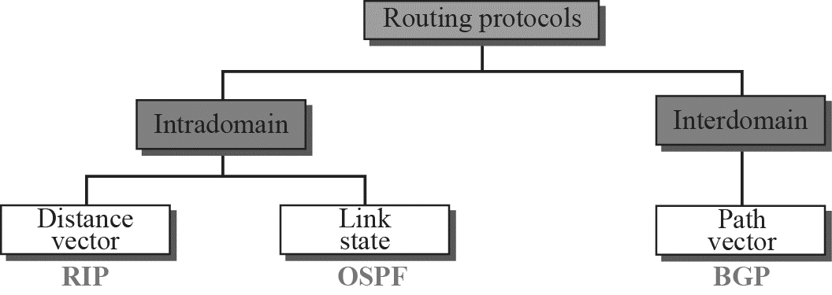
Popular Routing Protocols

Slide 4
Autonomous Systems
Internet is divided into autonomous systems.
An autonomous system (AS) is a group of networks and routers under the authority of a single administration.
Routing inside an autonomous system is called intra-domain routing. Routing between autonomous systems is called inter-domain routing.

Slide 5
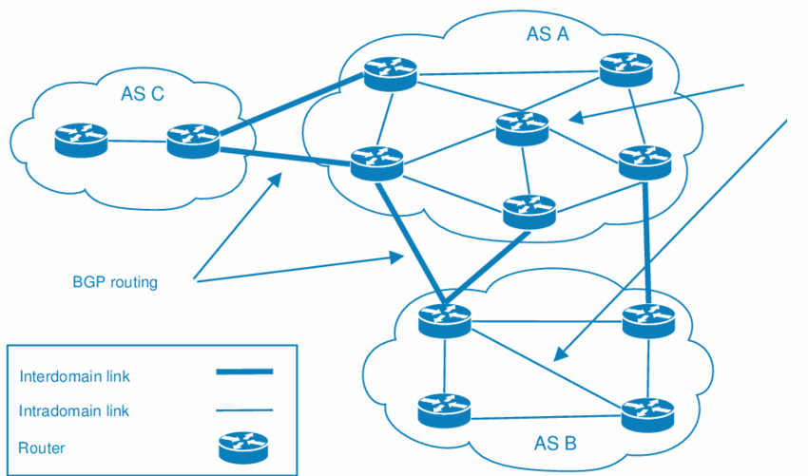
Autonomous Systems
RIP/ OSPF

Slide 6
Routing Algorithms
Given a set of routers and links connecting the routers.
Routing algorithm finds a “good” path from the source to destination router.
Good path = Least cost path

Slide 7
Routing Algorithm classification
Static or dynamic?
Static:
routes change slowly over time
Manually configured
Dynamic:
routes change more quickly
in response to link cost changes

Slide 8
Routing Algorithm classification
Global or Decentralized
Global:
all routers have complete topology and link cost info
“link state” algorithms
Decentralized:
router knows physically-connected neighbors, link costs to neighbors
iterative process of computation, exchange of info with neighbors
“distance vector” algorithms

Slide 9
Routing on a Graph
Essentially a graph theory problem
Network is a directed graph; routers are vertices
Find “best” path between every pair of vertices
In the simplest case, best path is the shortest path

Slide 10
Graph abstraction
5
v
3
w
2
5
u
2
1
z
3
1
2
x
y
1
Graph: G = (N,E)
N = set of routers = { u, v, w, x, y, z }
E = set of links ={ (u,v), (u,x), (u,w), (v,x), (v,w), (x,w), (x,y), (w,y), (w,z), (y,z) }
Notes:
‹#›

Slide 11
Graph abstraction: costs
5
c(x,x’) = cost of link (x,x’)
- e.g., c(w,z) = 5
v
3
w
2
5
u
2
1
z
3
1
2
x
y
1
Question: What’s the least-cost path between u and z ?
Routing algorithm: algorithm that finds least-cost path

Slide 12
Distance Vector Algorithm

Slide 13
Distance Vector Algorithm
Distributed:
each node receives info from one or more of its directly connected neighbors
Performs a calculations
Distributes the results back to its neighbors
Iterative
Process continues until no more info to exchange
Asynchronous:
All nodes operate independently
Notes:
‹#›

Slide 14
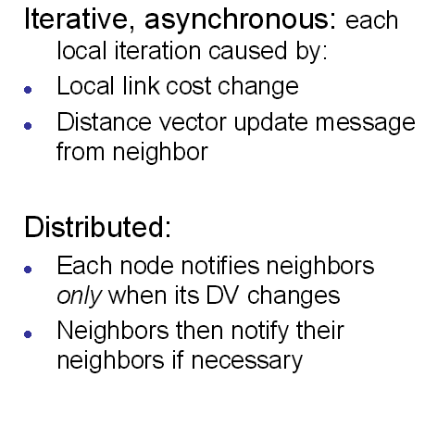
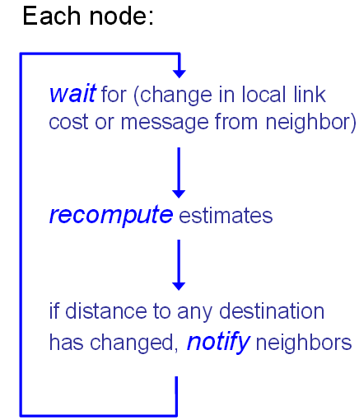
Distance Vector Algorithm

Slide 15
Distance Vector Algorithm
Bellman-Ford Equation Algorithm
computes shortest paths from a single source vertex to all of the other vertices in a weighted digraph.
Distributed route computation using only neighbor’s info

Slide 16
Distance Vector Algorithm
Objective:
d_{x}(y) := cost of least-cost path from x to y
Then
where min is taken over all neighbors v of x
d_{x}(y) = min _{v} {c(x,v) + d_{v}(y) }

Slide 17
Distance Vector Algorithm
With the Distance Vector Routing algorithm, the node x contains the following routing information:
For each neighbor v, the cost c(x,v) is the path cost from x to directly attached neighbor, v.
The distance vector x, i.e., D_{x} = [ D_{x}(y) : y in N ], containing its cost to all destinations, y, in N.
The distance vector of each of its neighbors, i.e., D_{v} = [ D_{v}(y) : y in N ] for each neighbor v of x.

Slide 18
Bellman-Ford example from u to z
5
U has 3 neighbors v, x and w
3
Clearly, d_{v}(z) = 5, d_{x}(z) = 3, d_{w}(z) = 3
v
w
2
5
u
z
B-F equation says:
2
1
3
1
2
d_{u}(z) = min { c(u,v) + d_{v}(z),
c(u,x) + d_{x}(z),
c(u,w) + d_{w}(z) }
= min {2 + 5,
1 + 3,
5 + 3} = 4
x
y
1
Node that achieves minimum is the next hop in shortest path to a destination,
To go to z from u, x in the next hop in the forwarding table

Slide 19
Distance vector algorithm
Basic idea:
Each node periodically sends its own distance vector estimate to neighbors
When a node x receives new DV estimate from neighbor;
It updates its own DV using B-F equation:
Notes:
‹#›

Slide 20
D_{x}(y) = min{c(x,y) + D_{y}(y), c(x,z) + D_{z}(y)} = min{2+0 , 7+1} = 2
D_{x}(z) = min{c(x,y) + D_{y}(z), c(x,z) + D_{z}(z)}
= min{2+1 , 7+0} = 3
node x table
cost to
cost to
x y z
x y z
x
0 2 7
x
0
2
3
from
y
∞
∞
∞
from
y
2 0 1
z
∞
∞
∞
z
7 1 0
node y table
cost to
x y z
y
2
1
x
∞
∞
z
∞
2 0 1
x
from
y
7
z
∞
∞
∞
node z table
cost to
x y z
x
∞ ∞ ∞
from
y
∞
∞
∞
z
7
1
0
time

Slide 21
Dy(x) = min{c(y,x) + Dx(x), c(y,z) + D_{z}(x)} = min{2+0 , 1+7} = 2
Dy(z) = min{c(y,x) + Dx(z), c(y,z) + D_{z}(z)}
= min{2+7 , 1+0} = 1
node x table
cost to
cost to
x y z
x y z
x
0 2 7
x
0
2
3
from
y
∞
∞
∞
from
y
2 0 1
z
∞
∞
∞
z
7 1 0
node y table
cost to
x y z
x y z
y
2
1
x
∞
∞
x
0 2 7
z
∞
2 0 1
x
from
y
y
2
0
1
7
z
∞
∞
∞
z
7 1 0
node z table
cost to
x y z
x
∞ ∞ ∞
from
y
∞
∞
∞
z
7
1
0
time

Slide 22
Dz(x) = min{c(z,x) + Dx(x), c(z,y) + Dy(x)} = min{7+0 , 1+2} = 3
Dz(y) = min{c(z,x) + Dx(y), c(z,y) + Dy(y)}
= min{7+2 , 1+0} = 1
node x table
cost to
cost to
x y z
x y z
x
0 2 7
x
0
2
3
from
y
∞
∞
∞
from
y
2 0 1
z
∞
∞
∞
z
7 1 0
node y table
cost to
x y z
x y z
y
2
1
x
∞
∞
x
0 2 7
z
∞
2 0 1
x
y
from
2
0
1
7
from
y
z
∞
∞
∞
z
7 1 0
node z table
cost to
x y z
x y z
x
∞ ∞ ∞
x
0 2 7
from
y
from
y
2 0 1
∞
∞
∞
z
z
3
1
0
7
1
0
time

Slide 23
node x table
cost to
cost to
cost to
x y z
x y z
x y z
x
0 2 7
x
0 2 3
x
0 2 3
from
y
∞
∞
∞
from
y
2 0 1
from
y
2 0 1
z
∞
∞
∞
z
7 1 0
z
3 1 0
node y table
cost to
cost to
cost to
x y z
x y z
x y z
y
2
1
x
∞
∞
x
0 2 7
x
0 2 3
z
∞
2 0 1
x
from
y
from
y
2 0 1
from
y
7
2 0 1
z
∞
∞
∞
z
7 1 0
z
3 1 0
node z table
cost to
cost to
cost to
x y z
x y z
x y z
x
∞ ∞ ∞
x
0 2 7
x
0 2 3
from
y
from
y
2 0 1
from
y
2 0 1
∞
∞
∞
z
z
3 1 0
z
3 1 0
7
1
0
time

Slide 24
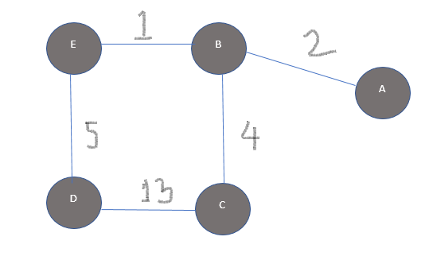
Example
How many iterations are needed to make the final routing tables of each router?
What will be the routing table of B and D after the 2nd iteration?

Slide 25
Network Layer Routing Algorithm Distance Vector Routing
Lecture 13 | Part 2| CSE421 – Computer Networks
Department of Computer Science and Engineering School of Data & Science

Slide 26
Operation of Distance Vector
Periodic Updates:
Periodically broadcast the entire routing table to each of its neighbors (RIP – every 30 seconds).
Inefficient
Router is only aware of the:
Network addresses of its own interfaces.
Network addresses the neighbors running the same routing protocol.
Notes:
Inefficient: Updates consume bandwidth and router CPU resources.
Periodic updates are always sent even there have been no changes for weeks or months.

Slide 27
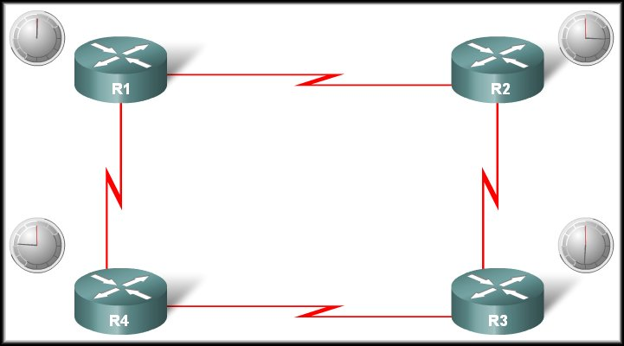

Operation of Distance Vector
Periodic Updates:
R1 Update Timer expires
Neighbour of R1
Updates sent.
Broadcast!
R1 is unaware of R3 and its networks
Neighbour of R1

Slide 28
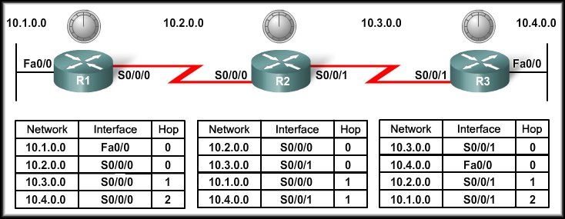
Distance Vector Routing Protocols
Network Discovery

Slide 29
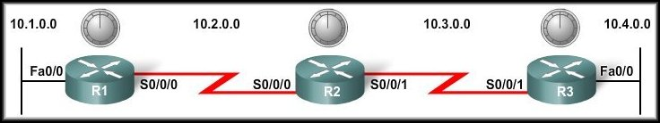
Cold Start
Network Discovery:
Is part of the process of the routing protocol algorithm that enables routers to learn about remote networks for the first time.

Slide 30
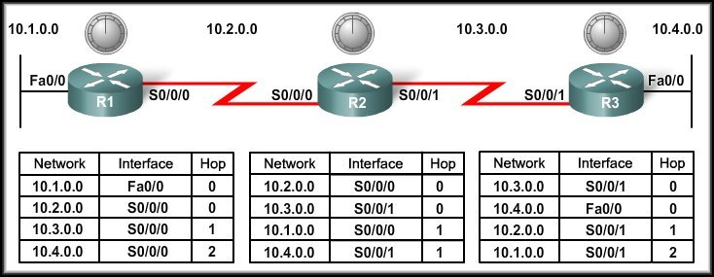
Cold Start
When a router powers up:
Knows nothing about the network topology.
Knows only the information saved in NVRAM.
Sends updates about its known networks out all ports.

Slide 31
Initial Exchange of Routing Information
10.1.0.0
Sends an update about network 10.1.0.0 out the Serial 0/0/0 interface with a metric of 1.
Sends an update about network 10.2.0.0 out the Fa0/0 interface with a metric of 1.

Slide 32
Initial Exchange of Routing Information
10.1.0.0
10.3.0.0
10.2.0.0
Notes:
Sends an update about network 10.3.0.0 out the Serial 0/0/0 interface with a metric of 1.
Sends an update about network 10.2.0.0 out the Serial 0/0/1 interface with a metric of 1.

Slide 33
Initial Exchange of Routing Information
10.1.0.0
10.4.0.0
10.3.0.0
10.2.0.0
Notes:
Sends an update about network 10.4.0.0 out the S0/0/0 interface with a metric of 1.
Sends an update about network 10.3.0.0 out the Fa0/0 interface with a metric of 1.

Slide 34
Initial Exchange of Routing Information
10.3.0.0
10.2.0.0
R1 Receives the update from R2 about network 10.3.0.0 and adds it to its routing table.
R3 Receives the update from R2 about network 10.2.0.0 and adds it to its routing table.

Slide 35
Initial Exchange of Routing Information
10.1.0.0
10.4.0.0
R2 Receives the update from R1 about network 10.1.0.0 and adds it to its routing table.
R2 Receives the update from R3 about network 10.4.0.0 and adds it to its routing table.

Slide 36
Next Exchange of Routing Information
10.1.0.0
Sends an update about network 10.1.0.0 out the S0/0/0 interface with a metric of 1 - AGAIN!
When R2 receives the update, there is no change in information so the update is ignored.

Slide 37
Next Exchange of Routing Information
NEW
NEW
10.3.0.0
10.4.0.0
10.1.0.0
10.2.0.0
Sends an update about networks 10.3.0.0 with a metric of 1 and 10.4.0.0 with a metric of 2 out the Serial 0/0/0 interface.
Similarly sends updates about networks 10.1.0.0 with a metric of 2 and 10.2.0.0 with a metric of 1 out the Serial 0/0/1 interface.

Slide 38
Next Exchange of Routing Information
10.4.0.0
Sends an update about network 10.4.0.0 out the S0/0/0 interface with a metric of 1 - AGAIN!
When R2 receives the update, there is no change in information so the update is ignored.

Slide 39
Next Exchange of Routing Information
10.3.0.0
10.4.0.0
R1 receives an update from R2 about network 10.3.0.0 and there is no change – update ignored.
R1 receives an update from R2 about network 10.4.0.0 (new) and adds it to its routing table.

Slide 40
Next Exchange of Routing Information
10.1.0.0
10.2.0.0
R3 receives an update from R2 about network 10.2.0.0 and there is no change – update ignored.
R3 receives an update from R2 about network 10.1.0.0 (new) and adds it to its routing table.

Slide 41
Next Exchange of Routing Information
The network has CONVERGED!
All routers now know about all of the networks attached to all of their neighbouring routers.

Slide 42
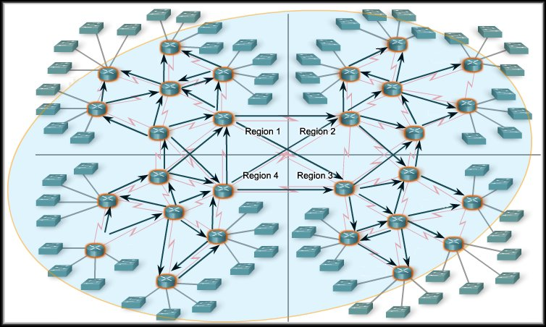
Convergence
The amount of time it takes for a network to converge is directly proportional to the size of that network.
Routing protocols are compared based on how fast they can propagate this information - their speed to convergence.
A network is not completely operable until it has converged.
Network administrators prefer routing protocols with shorter convergence times.

Slide 43
THE END

